Slide 1
Cell Cycle and Mitosis

Slide 2
Objectives
Describe the events of cell division in prokaryotes.
Name the two parts of the cell that are equally divided during cell division in eukaryotes.
Summarize the events of interphase.
Describe the stages of mitosis.
Compare cytokinesis in animal cells with cytokinesis in plant cells.
Explain how cell division is controlled.

Slide 3
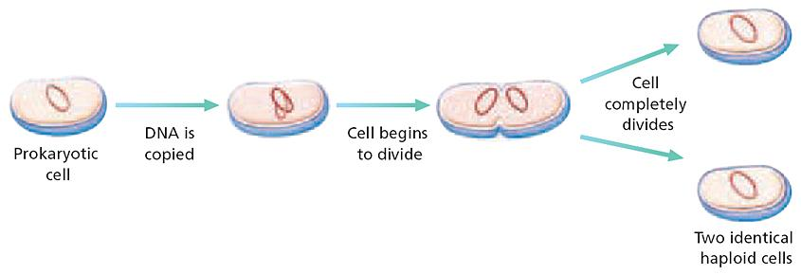
Cell Division in Prokaryotes
1. Cell division is the process by which cells reproduce themselves.
2. Binary fission is the process of cell division in prokaryotes.

Slide 4
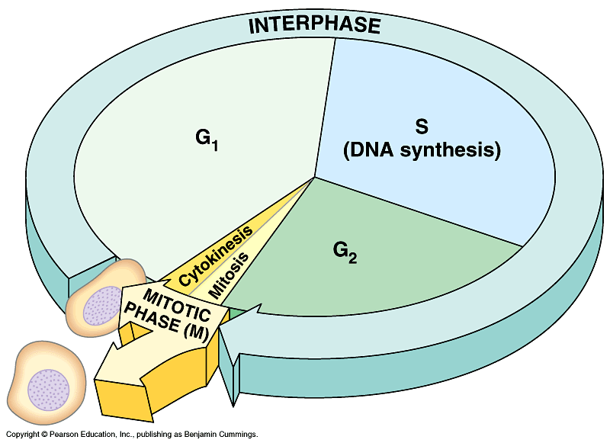
Cell Division in Eukaryotes
Cell Cycle
3. The cell cycle is the repeating set of events in the life of a cell.
The cell cycle consists of mitosis and interphase.

Slide 5
Cell Cycle - Interphase
4. Interphase: A period of growth between divisions.
G₁ Phase – Time when cell grows to full size
S Phase – Time when cell replicates DNA
G₂ Phase – Time when cell duplicates its organelles
G₀ Phase – Time when cell leaves cell cycle (not all cells do this. Example: Nerves)

Slide 6
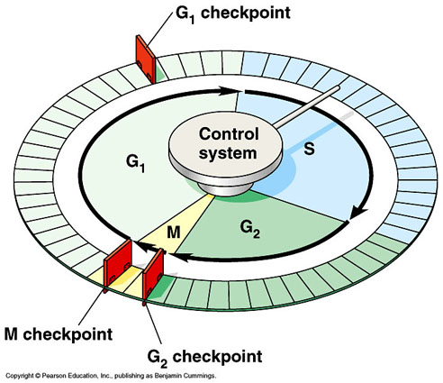
Control of Cell Division
Control occurs at three main checkpoints.
G₁
G₂
Mitosis
What happens when the control is lost?
Cancer may result if cells do not respond to control mechanisms.

Slide 7
M Phase: Mitosis and Cytokinesis
M-Phase consists of two processes!
5. Mitosis: Nuclear division
6. Cytokinesis: Cytoplasm and organelles divide

Slide 8
Mitosis: Nuclear Division

Slide 9
Mitosis
The Result is two daughter cells that are identical to the original cell!
Why does mitosis happen?
So that each daughter cell has exactly the same DNA as the parent cell.
How long does it take for mitosis to happen? About an hour.

Slide 10
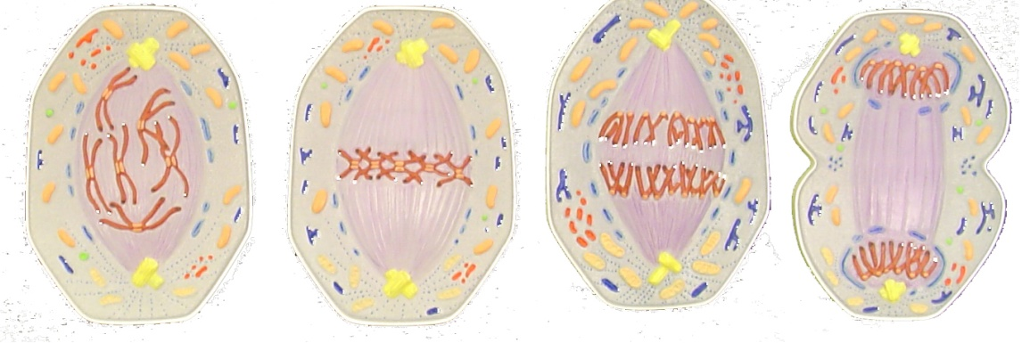
M Phase: Mitosis
Mitosis is divided into stages: prophase, metaphase, anaphase, and telophase. PMAT

Slide 11
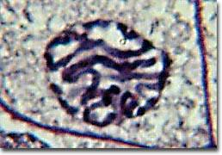
How does mitosis happen?
Prophase – The “Prepare” Phase
a. Nucleus Disappears
b. Centrioles move to poles
c. Spindle Fibers Set Up
d. Chromosomes form
Centrioles
Nucleus Vanishing
Chromosomes Winding

Slide 12
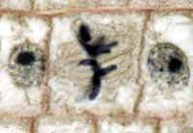
How does mitosis happen?
Metaphase – The “Middle” Phase
Centrioles build and break spindle fibers that move the chromosomes to the middle of the cell.
spindle
Chromosome

Slide 13
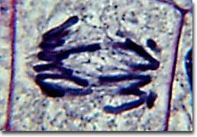
How does mitosis happen?
Anaphase – the “Away” Phase
Chromosomes are split into 2 separate sister chromatids
Sister Chromatids move away from each other to opposite sides of the cell.
Spindle
Sister Chromatid

Slide 14
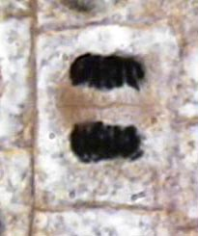
How does mitosis happen?
Telophase – “The End” Phase
Nucleus reappears
Spindle fibers break down
Chromosomes Unwind
Nucleus
Chromosomes Unwind

Slide 15
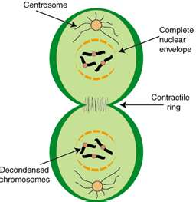
M Phase: Cytokinesis
Cytokinesis – after mitosis, the cytoplasm actually divides to make two new cells.

Slide 16
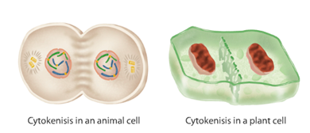
How Does Cytokinesis Work?
Plants: Plant cells rebuild the cell wall. The partially finished cell wall is called a cell plate.
Animals: Animal cells pinch in the cell membrane forming a cleavage furrow until both sides of the membrane meet, which separates the cells.
Cell Plate
Cleavage Furrow

Slide 17
Terms we just used that may require a review!
Centriole
Spindles
Sister Chromatids
Centromere (well, we actually didn’t use it yet…)
All of these are associated with DNA during Mitosis… So, let’s learn a little more about DNA!

Slide 18
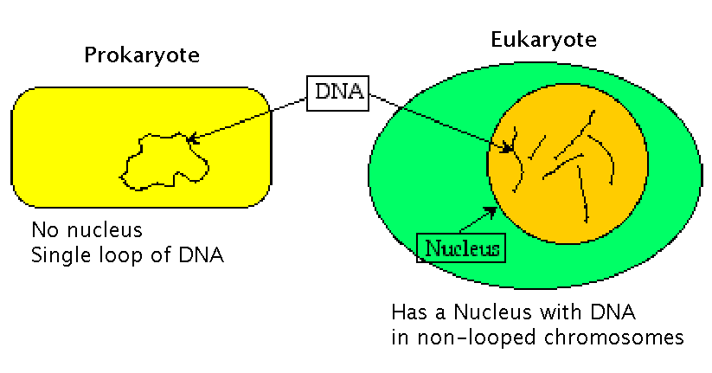
Chromosome Structure
Chromosomes in prokaryotes are simpler in structure than chromosomes in eukaryotes.

Slide 19
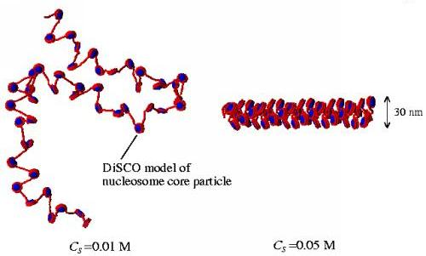
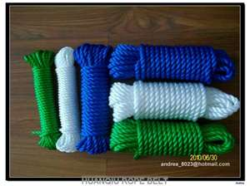
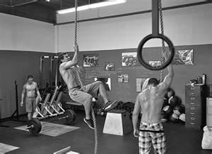
DNA in Different Forms
Chromatin
The form of DNA when it is not dividing
More relaxed form of DNA coiling
Chromosome
The form of DNA when the cell is dividing
More condensed form of DNA coiling
CHROMOSOME
CHROMATIN

Slide 20
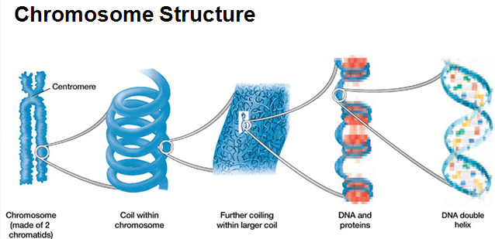
DNA Structure
In eukaryotes, DNA wraps around proteins called histones to help organize and compact DNA into the nucleus.

Slide 21
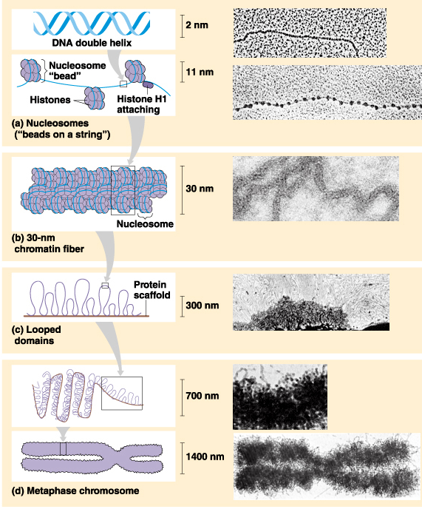
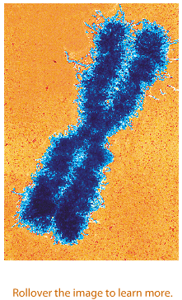
Chromosome Structure

Slide 22
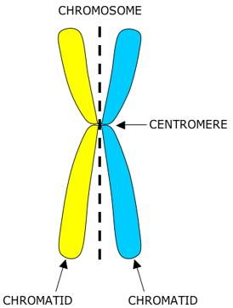
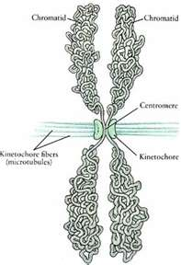
Chromosome Structure
Sister Chromatids – Copies of a chromosome
Copy made during s-phase of interphase
Centromere – The center of the chromosome that holds the 2 sister chromatids together
Label!

Slide 23
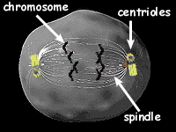
During Mitosis…
Centrioles – “tow truck”
use spindle to pull chromatids apart to opposite poles of the cell

Slide 24
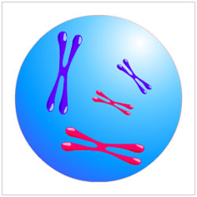
Diploid
Cells having two sets of chromosomes are diploid.
All human cells except reproductive cells (sperm and egg) are diploid
Diploid is abbreviated 2n

Slide 25
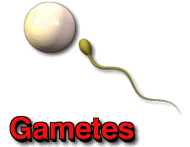
Haploid
Sperm cells and egg cells (gametes) are haploid cells, which contain only one set of chromosomes.
Have half the number of chromosomes that are present in diploid cells.
Haploid is abbreviated 1n.

Slide 26
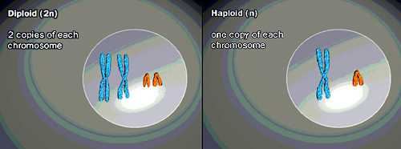
Diploid Vs. Haploid

Slide 27
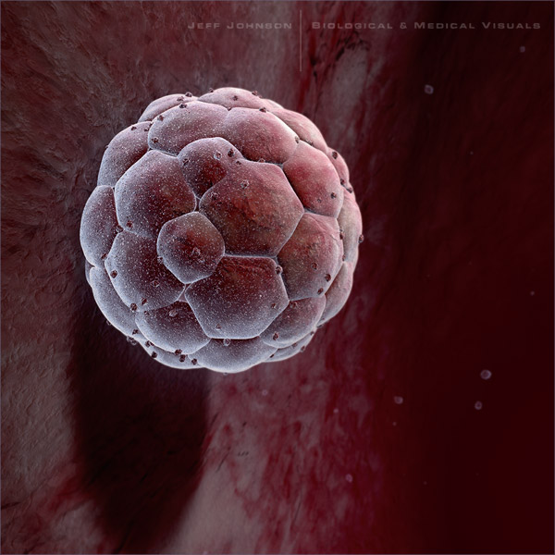
Review of Meiosis!
When a sperm cell(1n) and an egg cell (1n) combine to create the first cell of a new organism, the new cell will be dipolid (2n)
If the reproductive cells were diploid, the new cell would have too many chromosomes and would not be functional.

Slide 28
Videos
www.youtube.com/watch?NR=1&v=cvlpmmvB_m4&feature=endscreen
Cool one: www.youtube.com/watch?v=VGV3fv-uZYI
Condensing DNA: www.youtube.com/watch?v=gbSIBhFwQ4s

