Slide 1
DNA Notes!

Slide 2
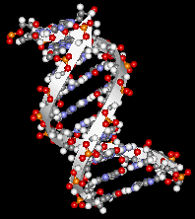
DNA
Made up of monomers called nucleotides
There are only four different nucleotides
The nucleotides are repeated over and over

Slide 3
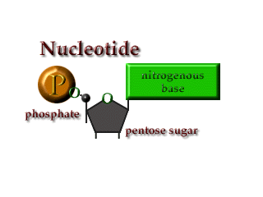
NUCLEOTIDES
4. A DNA nucleotide has three parts
A. Nitrogen Base
B. Phosphate Group
C. Deoxyribose Sugar

Slide 4
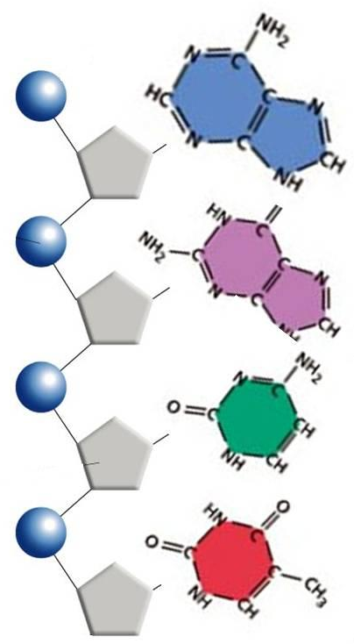
Nucleotides
5. The purines (Adenine & Guanine) have two rings of nitrogen bases
6. The pyrimidines (Thymine & Cytosine) have only one ring of nitrogen base
Adenine
Purines
Guanine
Cytosine
Pyrimidines
Thymine

Slide 5
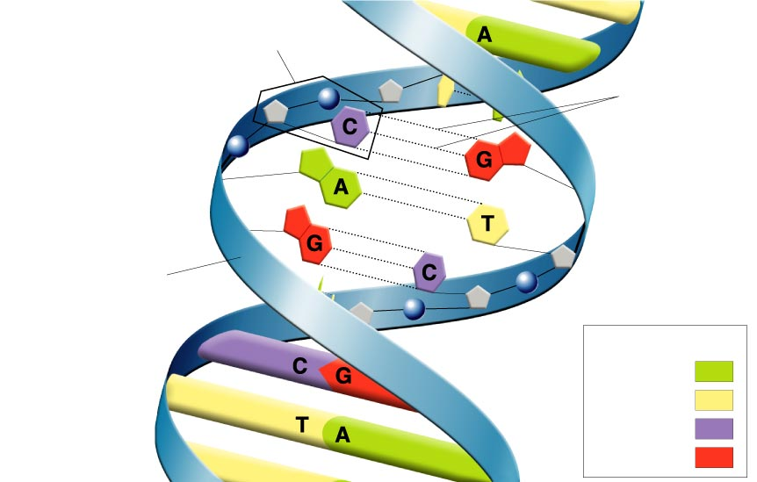
The “Ladder”
7. Label
8. Nucleotides line up in pairs to form a structure that looks like a ladder.
9. The sugar and phosphate groups make up the sides of the ladder
10. The base pairs make up the rungs of the ladder
Nucleotide
H-Bond
Sugar & Phosphate backbone
Key
Adenine (A)
Thymine (T)
Cytosine (C)
Guanine (G)

Slide 6
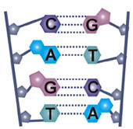
Complementary Base Pairing
The nucleotides only bond with certain other nucleotides
11. Cytosine forms three hydrogen bonds with Guanine
12. Adenine forms two hydrogen bonds with Thymine

Slide 7
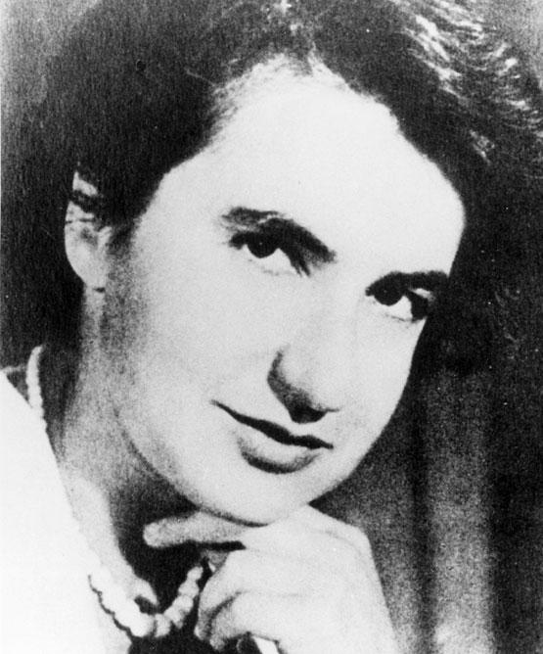
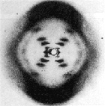
Franklin and Wilkins
13. Rosalind Franklin and Maurice Wilkins took the first X-ray photographs of DNA

Slide 8
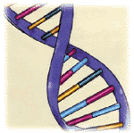
THE ^{14.}DOUBLE HELIX
Proposed by Watson and Crick in 1953
DNA is composed of two nucleotide chains that twist around to form a structure similar to a twisted ladder
Each turn has 10 base pairs

Slide 9
Video
http://ed.ted.com/lessons/the-twisting-tale-of-dna-judith-hauck

