Slide 1
DNA REPLICATION
Preparing for Mitosis

Slide 2
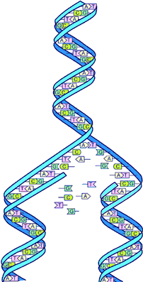
DNA REPLICATION
DNA IS COPIED
1. DURING S-phase of INTERPHASE
PREPARATION FOR CELL DIVISION

Slide 3
SEPARATION
2. THE STrAND OF DNA IS UNZIPPED BY HELICASE
3. THE POINT OF SEPARATION IS CALLED THE REPLICATION FORK

Slide 4
PREPARATION
4. The second enzyme, Primase, primes the dna for replication.
5. These partial sections are called Okazaki fragments.

Slide 5
NUCLEOTIDES ADDED
6. DNA POLYMERASE MOVE ALONG THE OPEN CHAINS AND MAKE NEW CHAINS WITH COMPLEMENTARY NUCLEOTIDES

Slide 6
FINALIZING THE NEW STRANDS
7. The final enzyme, Ligase, “lags” behind and reforms the phosphate & Sugar backbone

Slide 7
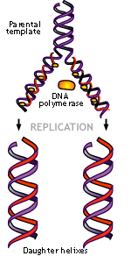
TWO STRANDS
8. NOW THERE ARE TWO STRANDS
EACH STRAND HAS HALF OF THE ORIGINAL STRAND
9. EACH Daughter STRAND IS IDENTICAL TO THE ORIGINAL STRAND

Slide 8
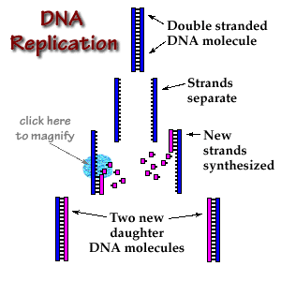

Slide 9
Unzipped by:
Helicase

Slide 10
Unzipped by:
Helicase
New base pairs added by:
DNA Polymerase
Primed by:
Primase

Slide 11
Unzipped by:
Helicase
New base pairs added by:
DNA Polymerase
Primed by:
Primase
Finalized by:
Ligase

Slide 12
Optional MOVIES
http://www.johnkyrk.com/DNAreplication.html
http://www.pbs.org/wgbh/aso/tryit/dna/#
http://www.ncc.gmu.edu/dna/repanim.htm
http://www.hhmi.org/biointeractive/dna-replication-basic-detail

