Slide 1
Genetic Engineering and Gene Expression

Slide 2
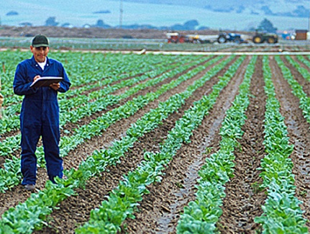
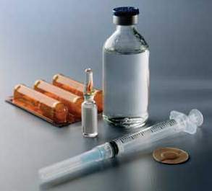
Genetic Engineering
1. The following are fields of science that use DNA technology such as Genetic Engineering:
Genetically modified crops
Pharmaceuticals
(ie Insulin)
Paternity Tests
C.S.I.

Slide 3
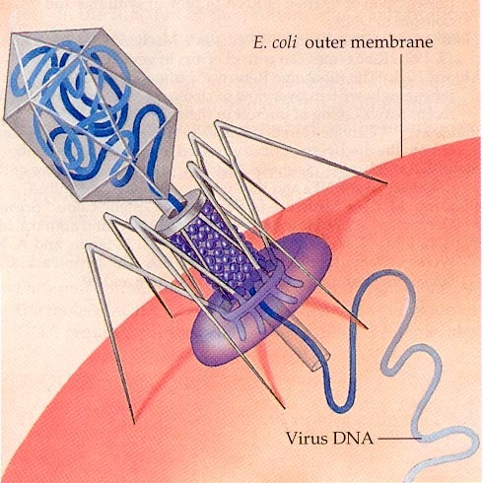
Genetic Engineering
2. Bacteria have a natural defense against these viruses called restriction enzymes. Restriction enzymes cut up the viral DNA at certain sequences.

Slide 4
Genetic Engineering
3. Each restriction enzyme only recognizes and cuts a specific nucleotide sequence on DNA. It will cut the DNA each time it encounters it.
4. The single stranded ends that result from the cutting are called “sticky ends.” These sticky ends will bond with complementary bases on other DNA molecules with the same sticky ends.

Slide 5
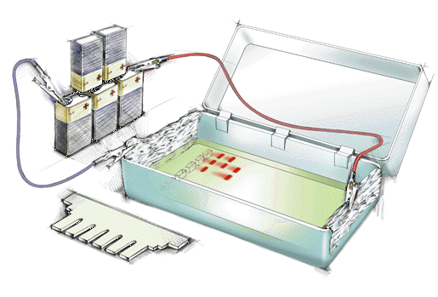
DNA Fingerprinting
5. Gel Electrophoresis is the process of sorting DNA fragments according to size.

Slide 6
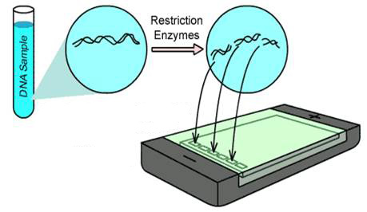
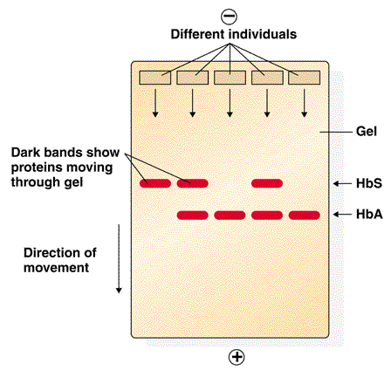
DNA Fingerprinting
6. DNA must first be cut into fragments before being loaded into a gel in order to sort them by size.

Slide 7
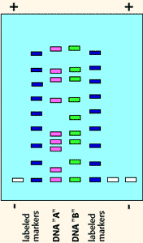
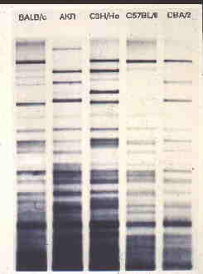
DNA Fingerprinting
7. Each suspect’s DNA must be cut with the same restriction enzyme.

Slide 8
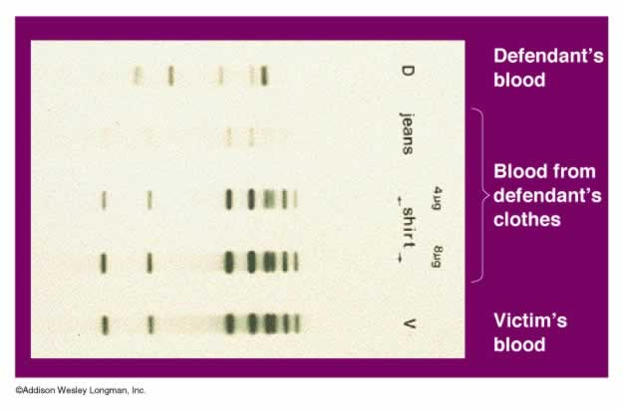

Slide 9
Recombinant DNA
8. Some common industries that use Recombinant DNA Technology:
Genetically modified crops
Pharmaceuticals
(ie Insulin)

Slide 10
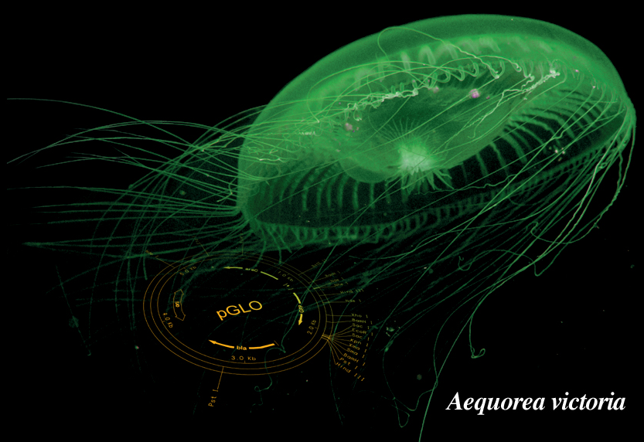
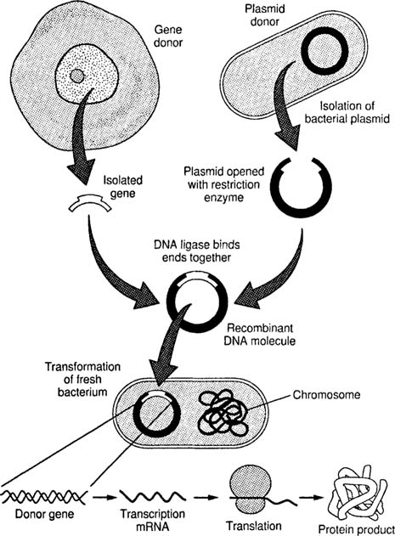
Recombinant DNA
9. Both the plasmid and target gene were cut using the same restriction enzyme.
10. Since the sticky ends would easily bond together, the target gene was spliced into the plasmid DNA.

Slide 11
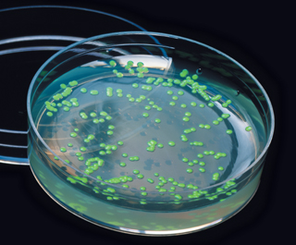
Recombinant DNA
11. It was the GFP protein that was produced through Transcription and Translation that actually glowed. DNA does not glow.

Slide 12
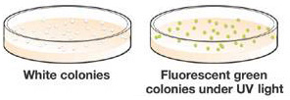
Gene Expression
No Sugar
Sugar
12. The bacteria grown without sugar did not glow because the GFP protein could not be produced. A repressor protein was blocking transcription of the gene.

Slide 13
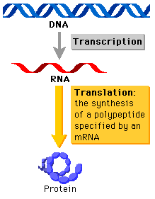
Gene Expression
13. Gene expression is the activation of a gene that results in transcription and the production of mRNA.
Only a fraction of any cell’s genes are expressed at any one time.

Slide 14
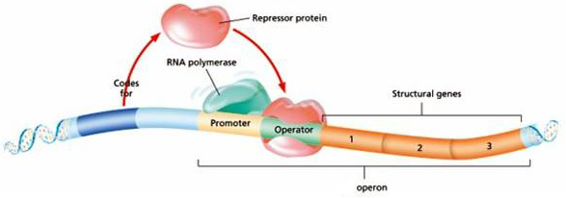
Gene Expression
14. Repressor proteins are coded for by regulator genes and these proteins inhibit genes from being expressed. They attach and physically block the advancement of RNA polymerase.

Slide 15
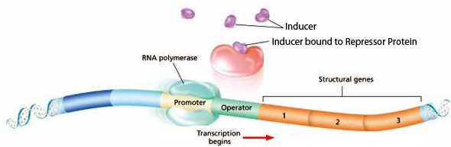
Gene Expression
15. An Inducer is a molecule that initiates gene expression by binding to the repressor protein causing it to detach. RNA polymerase can then advance to the structural genes.

Slide 16
Lac Operon Video

Slide 17
Gene Expression
No Sugar
Sugar
16. Sugar was the inducer in the pGlo lab by causing the repressor to detach, allowing the transcription of the GFP gene to occur.

