Slide 1
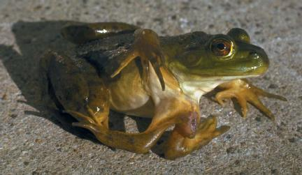
Gene Mutations

Slide 2
What is a mutation?
Mutation: a permanent change in the DNA sequence of a gene.
Mutations in a gene's DNA sequence can alter the amino acid sequence of the protein encoded by the gene.
Point mutation: single nucleotide base changes in a gene's DNA sequence.

Slide 3
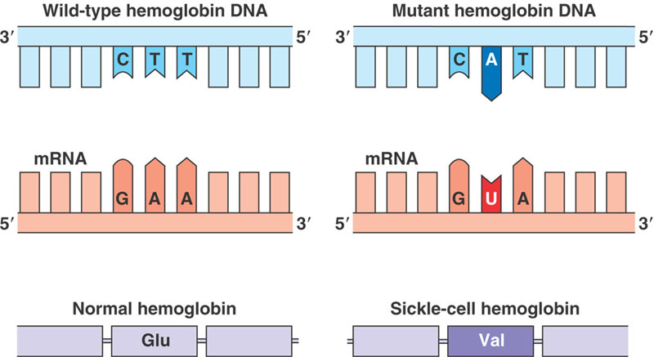
Point Mutations

Slide 4
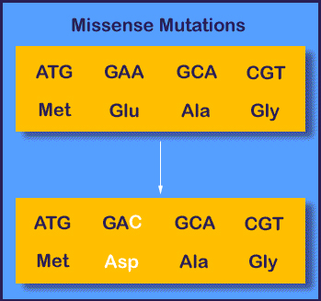
Missense mutations
Point mutations that result in a single amino acid change within the protein.

Slide 5
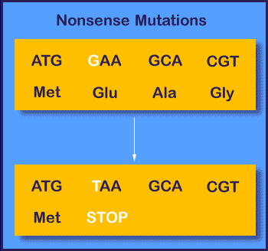
Nonsense mutations
Point mutations that create a premature "translation stop signal" (or "stop" codon), causing the protein to be shortened.

Slide 6
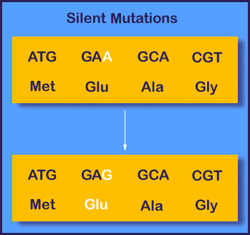
Silent Mutations
Point mutations that do not cause amino acid changes within the protein.
(Recall 64 codons for 20 Amino Acids)

Slide 7
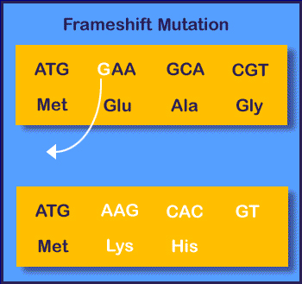
Insertions and Deletions
Add or remove one or more DNA bases.
Insertion and deletion cause frameshift mutations, which change the grouping of nucleotide bases into codons. This results in a shift of "reading frame" during protein translation.

Slide 8
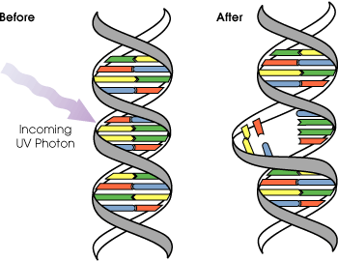
Mutation Rate
Calculated based on probability that the DNA will mutate spontaneously during a specific interval
Measured as # DNA base pairs changed per unit time
Spontaneous mutations = DNA replication errors
Non-spontaneous mutations:
Radiation: ionizing (X-Rays) & Nonionizing (UV light)
Chemicals: alkylating agents (methylate DNA), and carcinogens – act as alkylating agents.

Slide 9
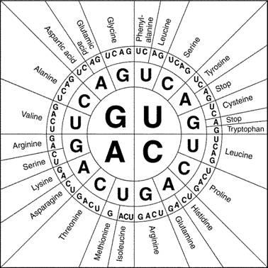
Mutation Practice Sentence
Write down this DNA sequence, and then transcribe (mRNA) and translate (AA) it using the codon chart:
TAC GGG GGC CTT ACC ACG ATC

