Slide 1
What Is Genetic Drift?
Genetic drift definition:
A random change in the frequency of alleles in a gene pool, usually due to small population size.

Slide 2
Genetic Drift: Chance Change A common misconception about evolution is that the features of organisms have evolved due to random chance alone
Random cause
of change
Mutations
Genetic Drift (small pops)
Gene flow**
** Migration can be random or non
Non-Random cause
of change
Non-random mating
Natural Selection
Gene flow**
- random

Slide 3
Genetic Drift: Changes due to chance events
Small populations are more prone to chance events causing change in allele frequencies
The creation of small populations from large ones can therefore increase likelihood of change
2 examples of events that make populations vulnerable to genetic drift are
Founder effect
Bottleneck effect
Berkeley – Understanding Evolution Bottlenecks and founder effects

Slide 4
Founder Effect

Slide 5
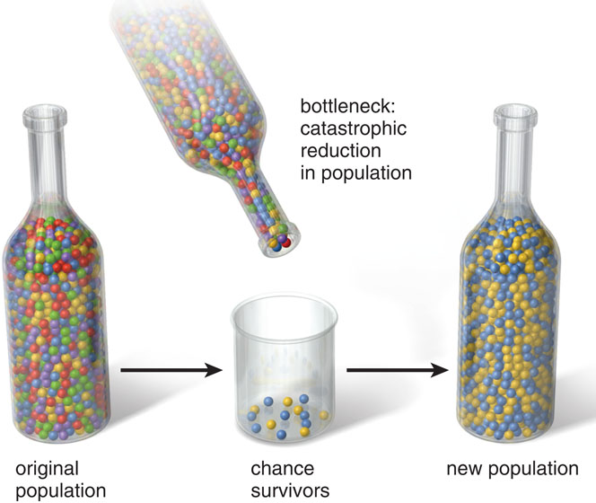
Bottleneck Effect

Slide 6
7 scenarios
Population at equilibrium
Population where mutations have occurred
Population experiencing gene flow
Population that has experienced the founder effect
Population that has experienced the bottleneck effect
Population that has experienced natural selection
Population that has experienced non-random mating

Slide 7
Design your experiment!
Consider the Strawfish and Population Genetics labs as a template
Using the beads provided, design a lab that would simulate your lab groups’ assigned condition and its effect over time
Determine logical number of generations (pop size is 10)
Set up a control (Round 1) and figure out what your H-W Equilibrium allele frequencies should be (How does this correspond to a null hypothesis?)
Check with me to make sure your design is appropriate before proceeding!
Run your experiment and collect data
When you collect data, only pull 10 individuals per round. The rest die.
Create your new population based on the frequencies of each allele
Run a chi-square analysis and determine whether or not to reject your null hypothesis
Be able to explain your results to the class!

Slide 8
Sample Table
Possible Outcomes | Expected (e) | Observed (o) | o-e | (o-e)² | (o-e)² e
X² = sum

Slide 9
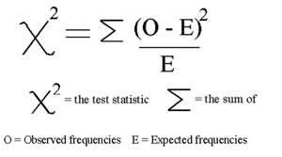
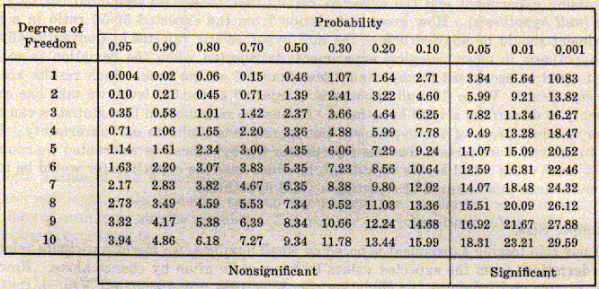
Chi Square Formula and Table

