Slide 1
Population Genetics
Hardy-Weinberg Equilibrium and Equations

Slide 2
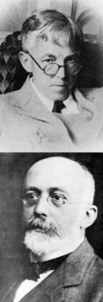
Hardy-Weinberg Law
The unifying concept of population genetics is the Hardy-Weinberg Law (named after the two scientists who simultaneously discovered the law).
1) The law predicts how gene frequencies will be transmitted from generation to generation.

Slide 3
Hardy-Weinberg Equilibrium
2) The two scientists showed that genotype frequencies in a population tend to remain the same from generation to generation under certain conditions. This is called equilibrium

Slide 4
3) The Hardy-Weinberg model consists of two equations:
one calculates allele frequencies (e.g. A or a)
one calculates genotype frequencies. (e.g. AA, Aa or aa)
Because we are dealing with frequencies, both equations must add up to 1 or 100%.

Slide 5
Equation #1
4) The frequency of dominant allele + the frequency of recessive allele will = 1
p + q = 1
5) p= frequency of the dominant allele (e.g. A)
5) q= frequency of the recessive allele (e.g. a)

Slide 6
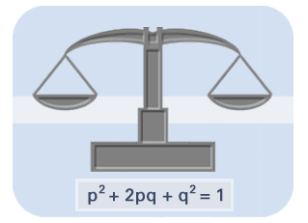
Equation #2
6) Equation #2 predicts the frequencies of genotypes in a population
p²+ 2pq + q² = 1
7)
(e.g. AA)
(e.g. Aa)
(e.g. aa)

Slide 7
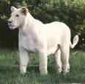
Sample Problems
In lions the allele for the albino trait is recessive over the normal tawny-striped coloration. A sample of 100 wild lions was examined, and it was determined that 9 of these lions were white (aa). How many lions in this population would you expect to be heterozygous for the albino trait? How many homozygous and tawny colored?

Slide 8
In nearly all H-W problems, q² is the starting point!

Slide 9
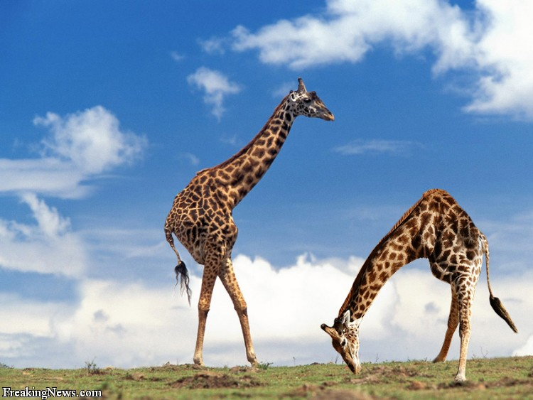
What conditions can alter Hardy Weinberg equilibrium?
1) Mutations Happen – and they produce new alleles that enter the population.

Slide 10
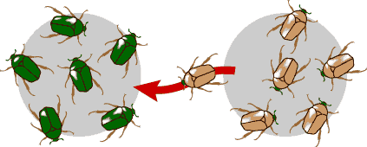
What conditions can alter Hardy Weinberg equilibrium?
2) Gene Flow - migration of individuals into or out of the population changes the frequency of alleles in a gene pool (total alleles in the population)

Slide 11
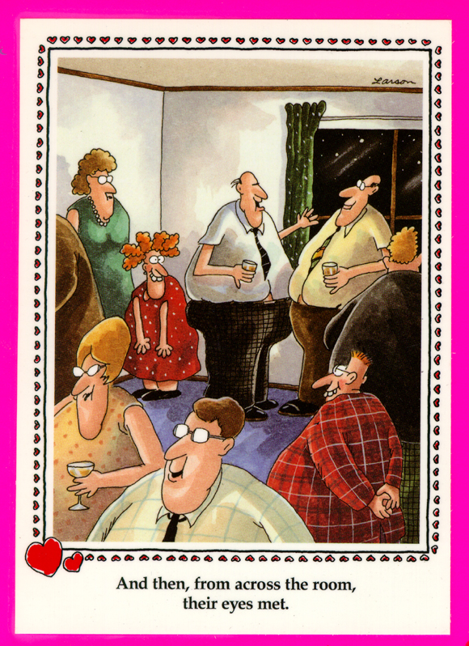
What conditions can alter Hardy Weinberg equilibrium?
3) Mating is NOT random - individuals DO NOT pair by chance. Selecting mates based on their genetics will alter the allele frequencies in a gene pool.

Slide 12
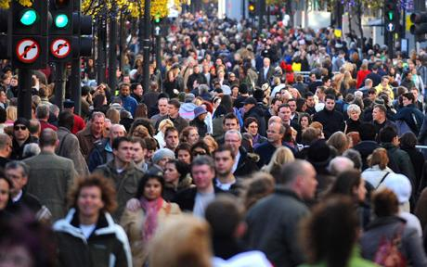
What conditions can alter Hardy Weinberg equilibrium?
4) A small population. Small populations can lead to a phenomenon called genetic drift in which random chance can cause the allele frequencies to change.

Slide 13
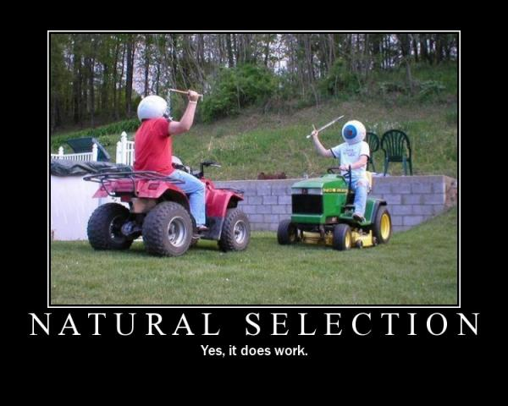
What conditions can alter Hardy Weinberg equilibrium?
5) A Mode of Selection - Any selection for or against alleles will alter their frequencies in a population.

Slide 14
Are these 5 assumptions valid?
If most of the H-W assumptions are not realistic, why do we bother?
Allows us to establish a baseline of comparison and helps determine which assumption(s) is/are NOT being met and are driving the evolution of the population.

