Slide 1
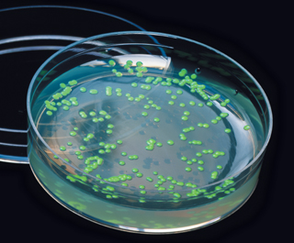
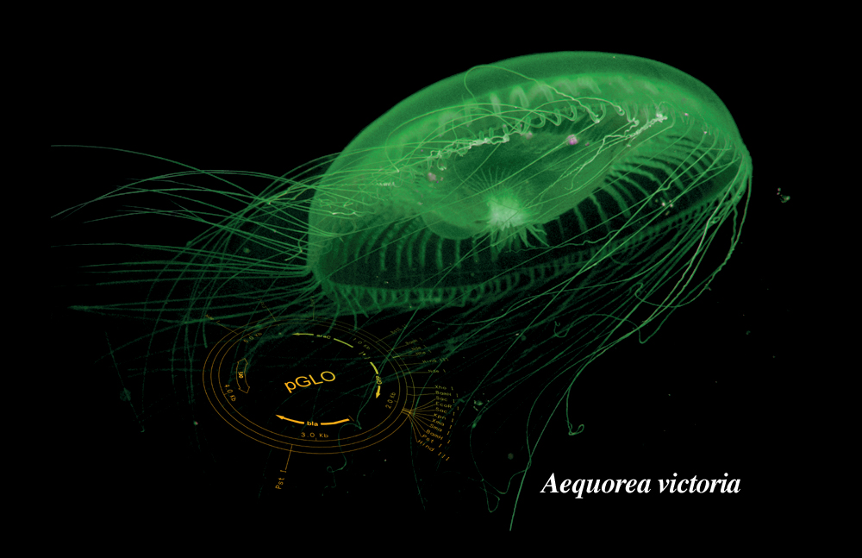
Introduction to the pGLO Lab

Slide 2
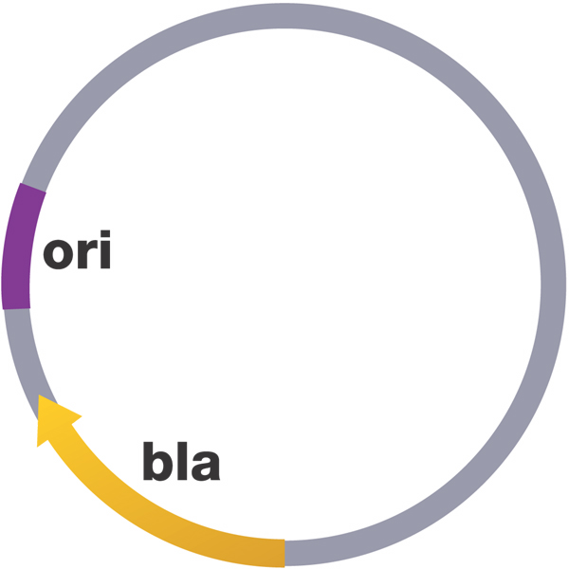
What is a plasmid?
A circular piece of DNA found in bacteria separate from their genome
Provides beneficial genes, such as antibiotic resistance
Useful for DNA technology: splice in gene of interest, put back into bacteria to grow…VOILA…lots of copies of the gene!

Slide 3
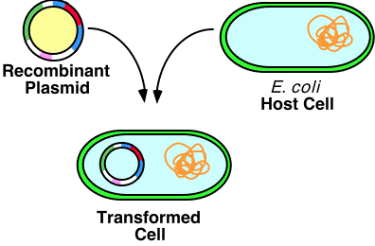
What is our gene of interest in this lab?
GFP = Green Fluorescent Protein
Found in the jellyfish species Aequorea victoria
Biotech company already spliced GFP gene into the pGLO plasmid
We are going to put the recombinant plasmid into E. coli bacteria to grow

Slide 4
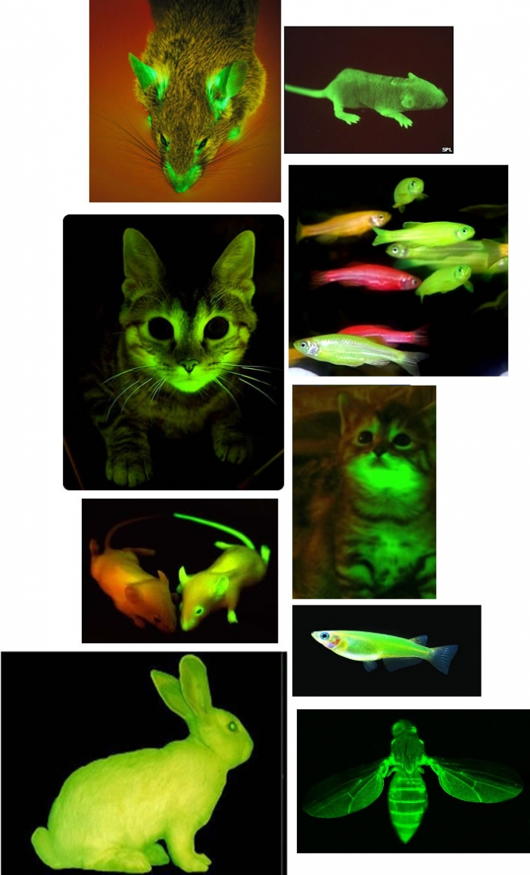
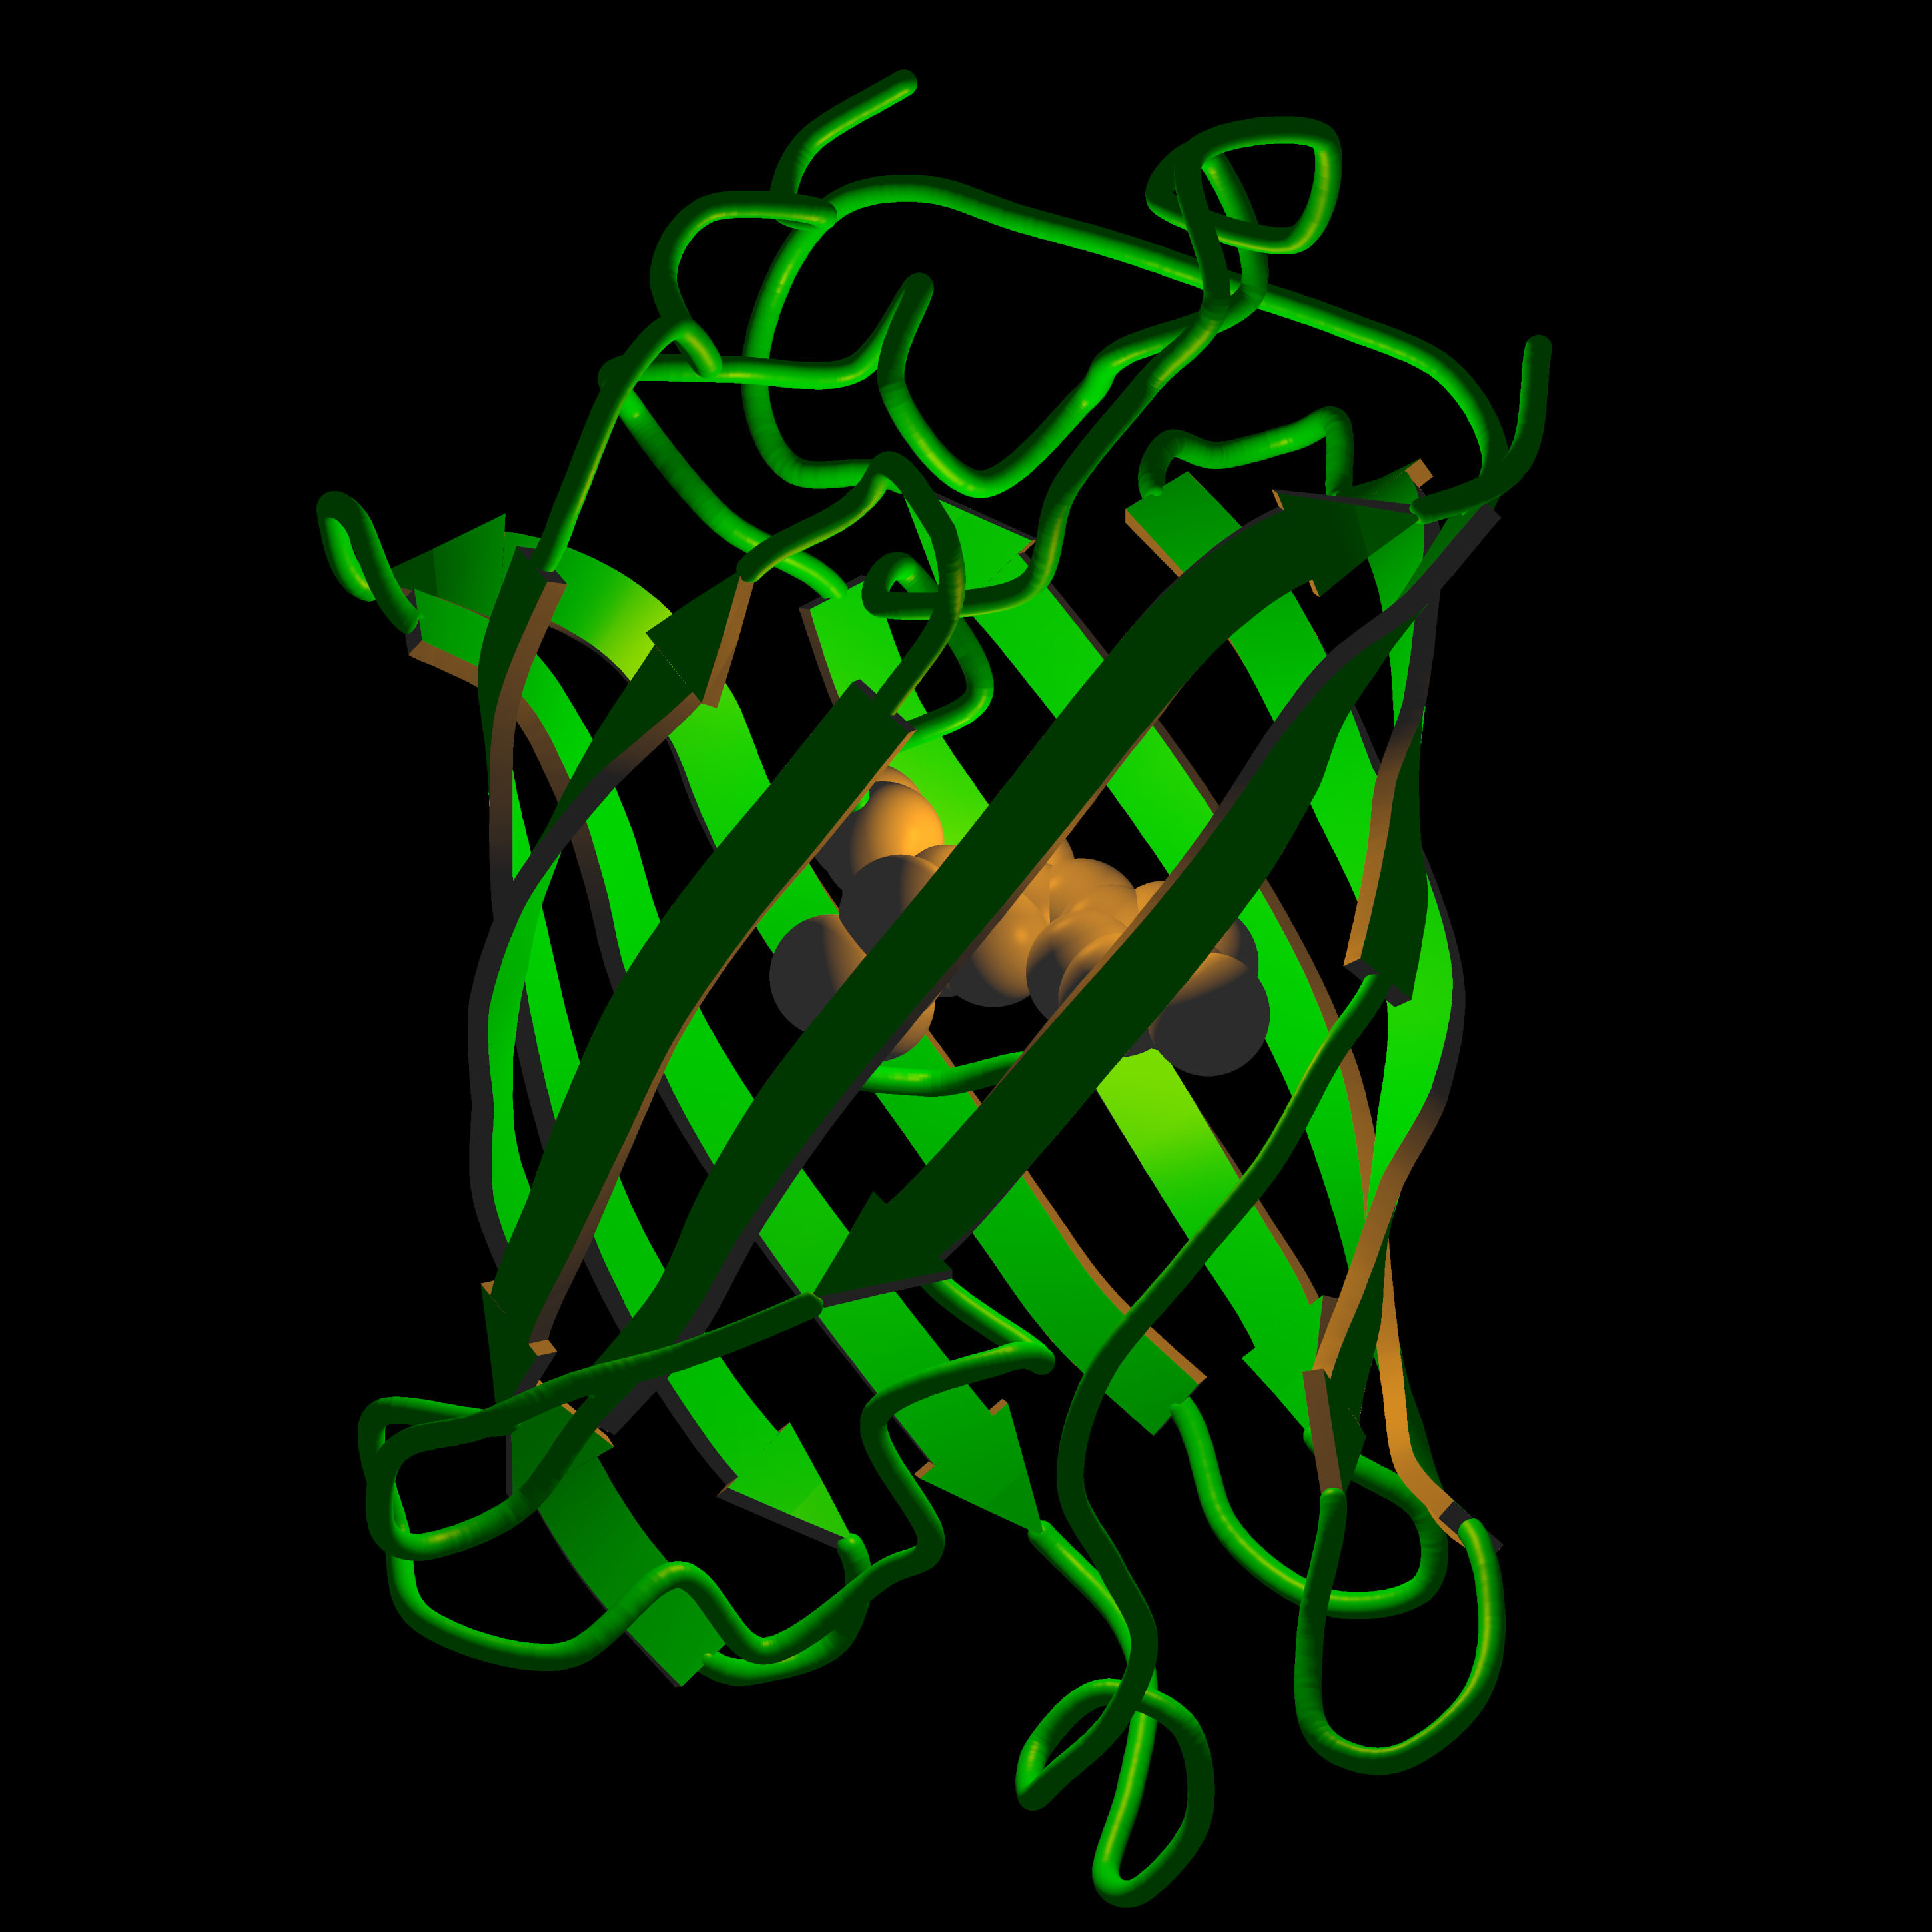
Why is GFP so cool?
It glows in the dark (fluoresces green)!!!
We will shine a UV light to our plate and hopefully see green colonies!

Slide 5
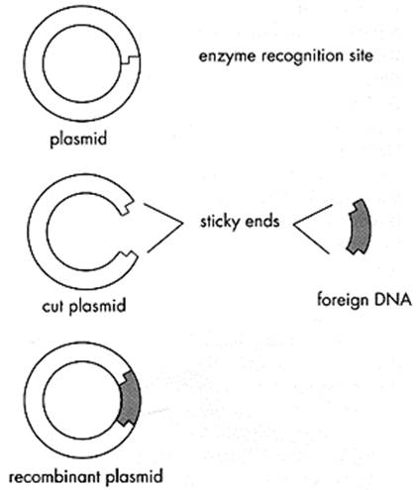
Can you elaborate on this “splicing” of DNA?
First, the pGLO plasmid and the GFP gene (from the jellyfish) had to be cut by the same restriction enzyme. This produced sticky ends.
Second, the sticky ends of the isolated GFP gene and plasmid were matched up. Now it is a recombinant plasmid
Recombinant = contains genetics information from multiple sources

Slide 6
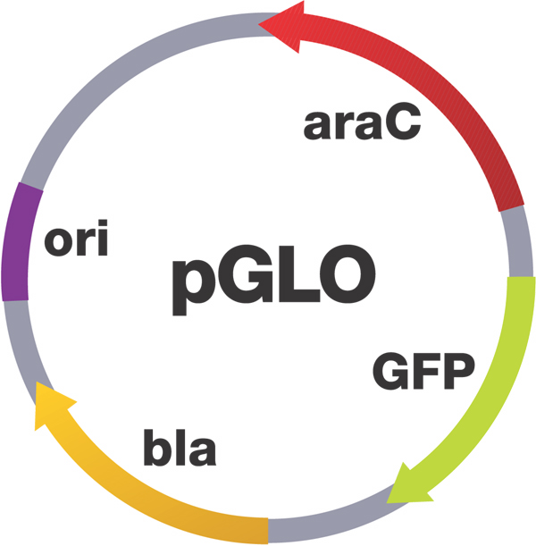
Some genes to know in the pGLO plasmid
araC regulator protein
Regulates GFP transcription
Green Fluorescent Protein (GFP)
Aequorea victoria jellyfish gene
Beta Lactamase
Ampicillin resistance

Slide 7
What is Bacterial Transformation?
Uptake of foreign DNA, often a circular plasmid
Goal: Get pGLO plasmids into E. coli bacteria
Cell wall
GFP
Bacterial
chromosomal DNA
Beta lactamase
(ampicillin resistance)
pGLO plasmids

Slide 8
What do we need to do to make Bacterial Transformation successful?
Calcium Chloride + Heat-Shock:
CaCl₂ – Plasmid DNA sticks to bacterial cell walls
Heat-Shock (ice → heat → ice) – Cell membrane becomes porous – plasmid can “sneak” in through holes
Transformation Animation

Slide 9
Transformation Procedure
Suspend E. coli starter culture in Transformation solution (CaCl₂)
Add pGLO plasmid DNA
Place tubes in ice
Heat-shock at 42°C and place on ice
Incubate with nutrient broth
Streak plates
Grow overnight in incubator

Slide 10
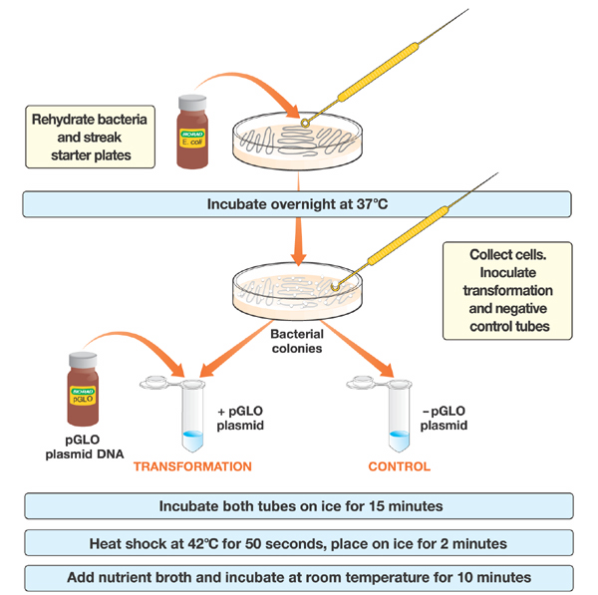
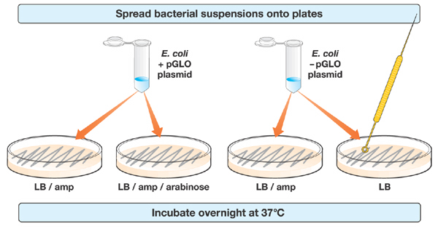
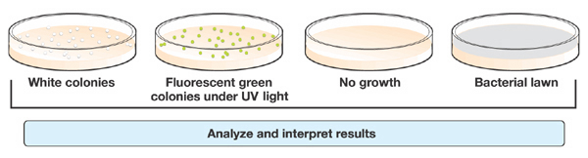
Transformation Procedure
Day 1
Day 2

