Slide 1
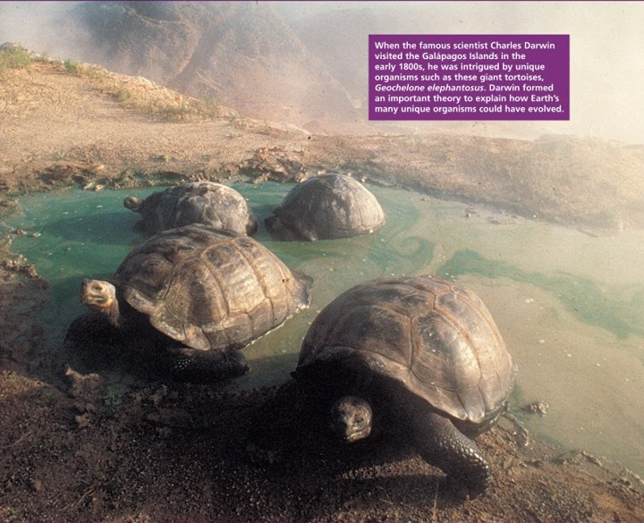
Evidence of Evolution

Slide 2
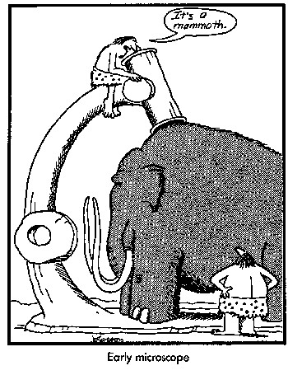

Slide 3
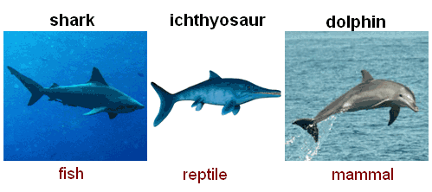
Convergent Evolution
In convergent evolution, organisms that are not closely related resemble each other because they have responded to similar environments.

Slide 4
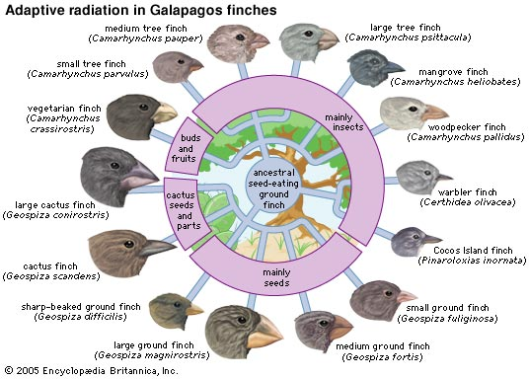
Divergence and Radiation
In divergent evolution, related populations become less similar as they respond to different environments.
Adaptive radiation is the divergent evolution of a single group of organisms in a new environment.

Slide 5
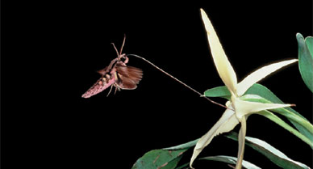
Coevolution
Coevolution: The term coevolution is used to describe cases where two (or more) species reciprocally affect each other’s evolution.

Slide 6
Coevolution

Slide 7
Coevolution
TREE SHREW TOILET!!!
Mountain tree shrews feed on the nectar coating the undersides of pitcher plant leaves. Conveniently, they can also defecate into the pitcher, leaving nitrogen-rich feces for the plant to consume.

Slide 8
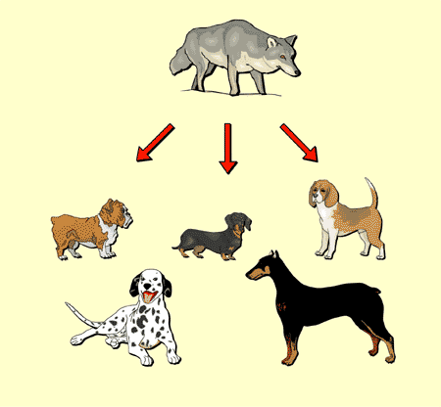
Artificial Selection
Artificial selection (or selective breeding) describes intentional breeding for certain traits, or combination of traits
The great variety of dog breeds is an example of artificial selection.

Slide 9
Genetic Divergence
Genetic divergence is found when populations are separated and accumulated genetic differences.
Genetic divergence promotes speciation.

Slide 10
Reproductive Isolating Mechanisms
Any heritable feature of body form, functioning, or behavior that prevents interbreeding between one or more genetically divergent populations.
Can be either prezygotic or postzygotic.

Slide 11
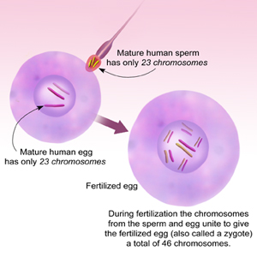
Prezygotic Isolation Mechanisms
Method of reproductive isolation that occurs even before a zygote is produced.
Zygote = first stage of embryonic development after fertiliztion

Slide 12
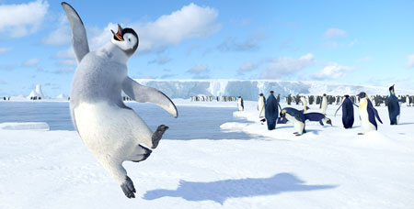
Behavior Isolation
When behavior of individuals in populations of similar organisms prevent mating.
Ex: birds…

Slide 13
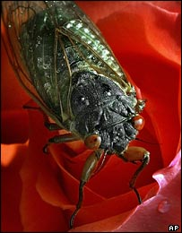
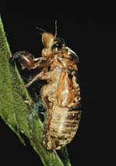
Temporal Isolation
When similar organisms are isolated by timing – they just aren’t around when their sister species are…
Ex: Cicadas
These two cicada species will only be able to share their genes once every 221 years.

Slide 14
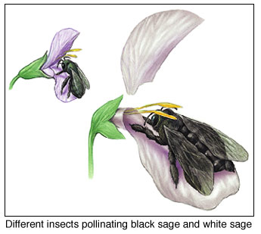
Mechanical Isolation
The parts don’t match up…
This could be outwardly physical, or gametic.
Mechanical isolation occurs because the genital organs of different species are incompatible. Even if members of two species court and attempt copulation, mating is not successful. In plants, mechanical isolation often occurs in flowering plants pollinated by insects. The flowers of black sage and white sage are structurally different and are pollinated by different species of insects. In this example, each insect species pollinates flowers of only one of the sage species. Therefore, interbreeding does not occur.

Slide 15
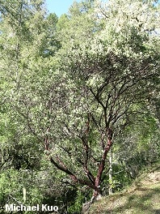
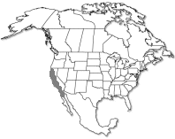
Ecological Isolation
Populations are adapted to different microenvironments…
Example: manzanitas in the Sierra Nevada

Slide 16
Gametic Mortality
Gametes of different species are incompatible at a molecular level.
Pollen may not grow a pollen tube, because it doesn’t recognize the stigma…
Sperm cannot penetrate the egg…
EGG

Slide 17
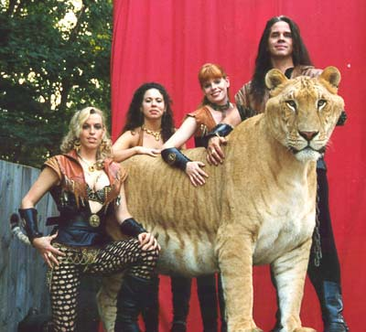
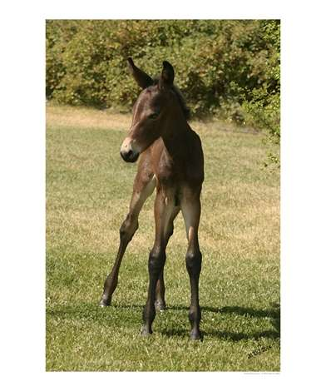
Postzygotic Isolation
Act during or after embryonic development.
May result in:
Early death of offspring
Sterility
Low fitness (weak offspring)
Low survival rates
Few sturdy but sterile hybrids: mule

Slide 18
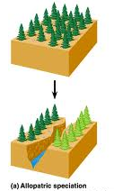
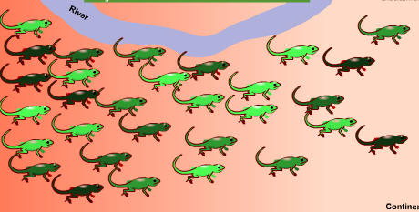
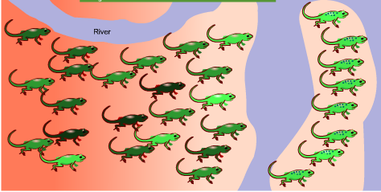
Types of Speciation
Allopatric
Allo – different
Patry – homeland
Speciation arises from physical separation between populations.

Slide 19
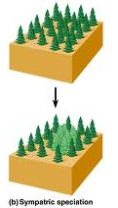
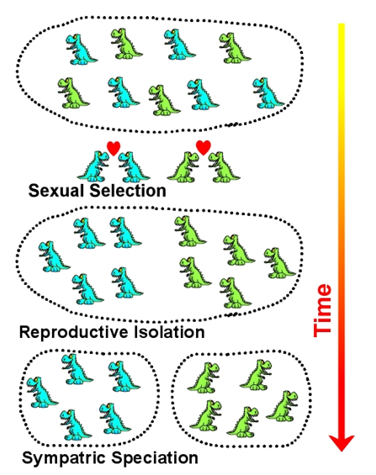
Sympatric Sym – together
No physical barriers between groups, but for some reason they are separate species.

Slide 20
Parapatric
Para - near
In parapatric speciation there is no specific extrinsic barrier to gene flow. The population is continuous, but nonetheless, the population does not mate randomly. Individuals are more likely to mate with their geographic neighbors than with individuals in a different part of the population’s range. In this mode, divergence may happen because of reduced gene flow within the population and varying selection pressures across the population’s range.

Slide 21
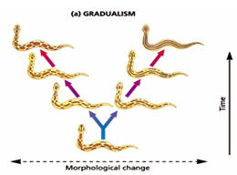
Gradualism Model of Speciation
Phyletic gradualism is a hypothesis about the pattern of evolution. In contrast to the theory of punctuated equilibrium, it states the following:
• Evolution has a fairly constant rate.
• New species arise by the gradual transformation of ancestral species.
• The rate of evolution during the origin of new species is much like that at any other time.

Slide 22
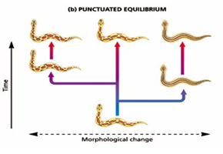
Punctuated Model of Speciation
Punctuated equilibrium is a theory in evolutionary biology which proposes that most sexually reproducing species will experience little evolutionary change for most of their geological history (in an extended state called stasis). When evolution occurs, it is localized in rare, rapid events of branching speciation.

