Slide 1
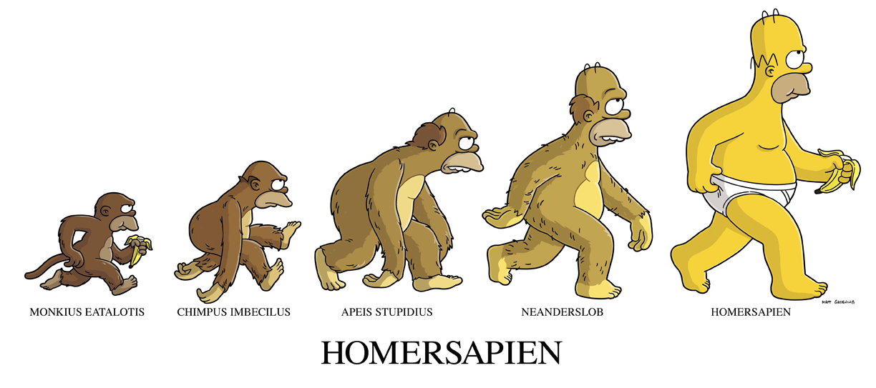
The Making of the Fittest
Evidence of Evolution https://www.youtube.com/watch?v=Ci9jfMvoLb4

Slide 2
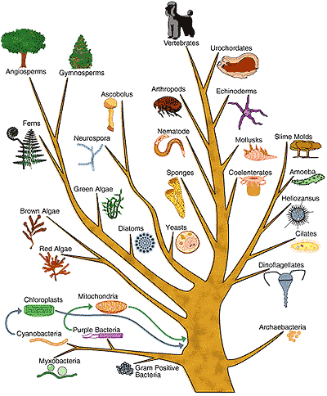
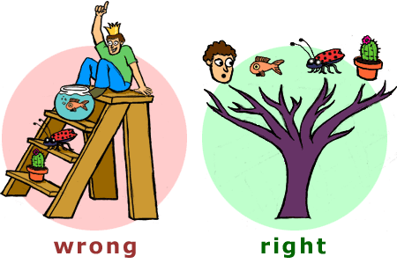
Evolution
Evolution is the change in the frequency of alleles, or different versions of genes, in a population. Over generations theses changes lead to new types of organisms developed from preexisting types

Slide 3
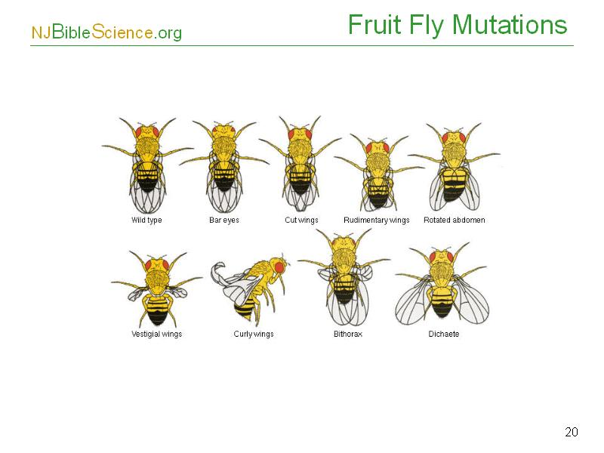
How do we get genetic variation?
Mutations are the raw material for genetic variation
  They are random, unintentional changes in the DNA information

Slide 4
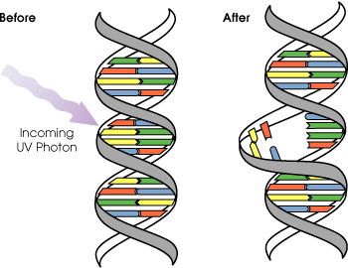
What causes mutations?
A mutation is a permanent change in the DNA sequence of a gene.
Mutation Rate:
  probability that the DNA will mutate spontaneously during a specific interval.
Non-spontaneous mutations:
  Radiation: X-Rays and UV light
  Chemicals: Alkylating agents and carcinogens

Slide 5
The
Molecular Clock
Hypothesis
Amount of genetic difference between species is a function of time since separation.
Rate of molecular change due to mutation rate is constant (enough) to predict times of divergence.

Slide 6
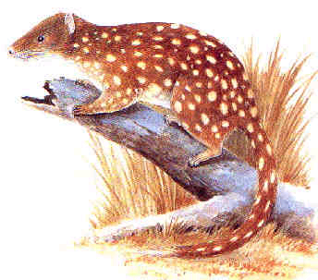
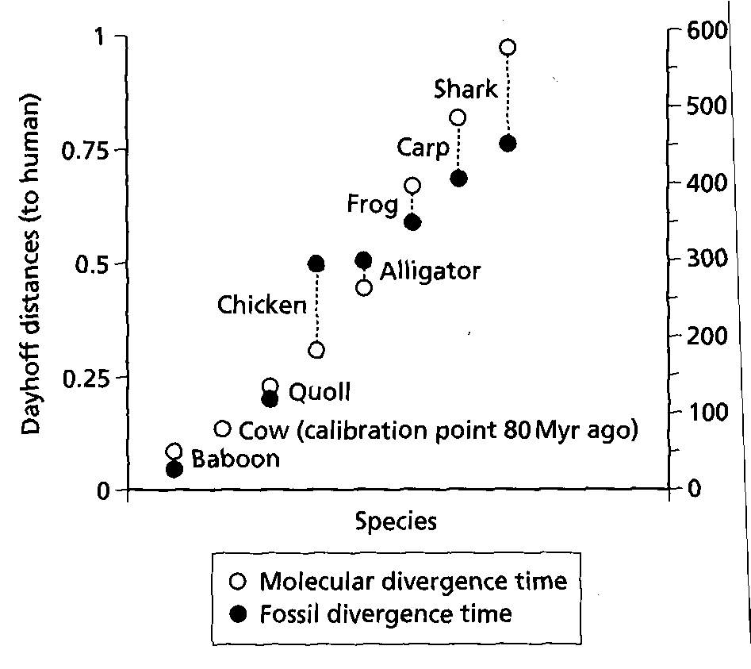
How do we check the “clock” to make sure it tells the correct time?
Large carniverous marsupial

Slide 7
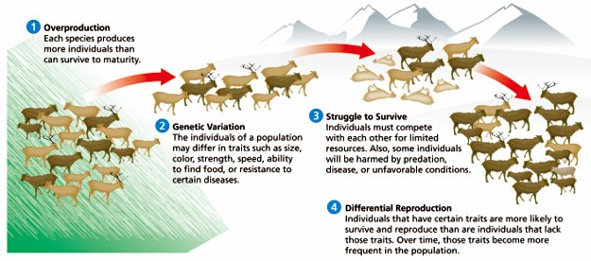
How does evolution work?
Natural selection is the mechanism for evolution, acting upon those genetic variations.

Slide 8
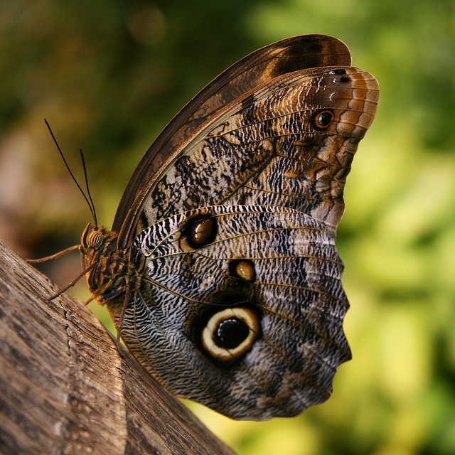
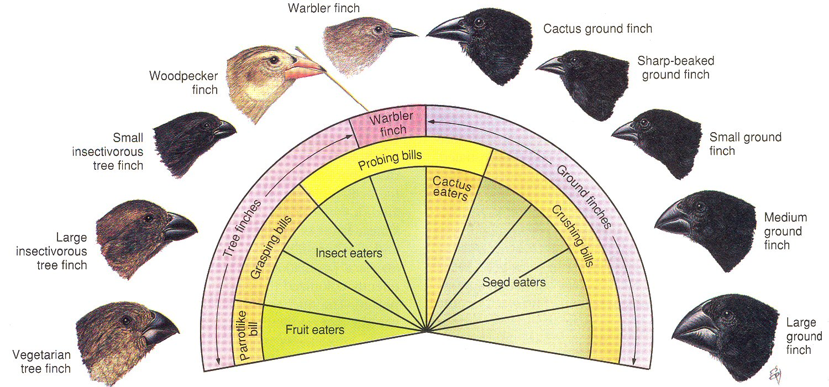
Which variations are likely to survive?
Adaptations are genetic variations that increase the likelihood of survival for an individual
Examples???

Slide 9
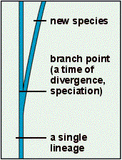
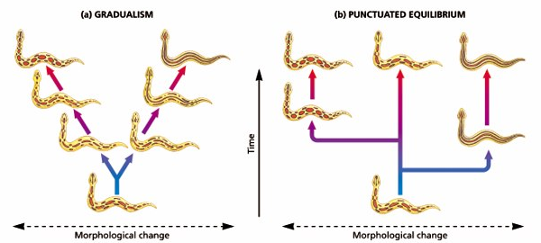
How do these changes produce new species?
Genetic divergence is the process by which populations are separated and genetic differences accumulate
  Genetic divergence promotes speciation
Speciation is the production of new species

Slide 10
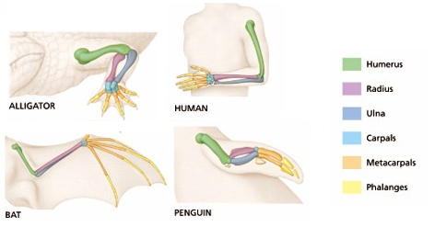
How do ancestral traits change over time?
Homologous structures are similar body patterns in different species that show common ancestry between these species.
  Result of divergence - basis of “Descent with Modification”

Slide 11
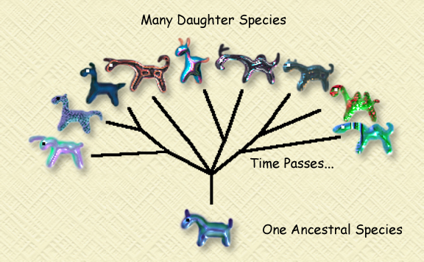
What does it mean for species to be closely related?
The relatedness of species correlates with the occurrence of genetic divergence of their common ancestor
  The more recent the genetic divergence occurred, the more closely related the 2 species are.

Slide 12
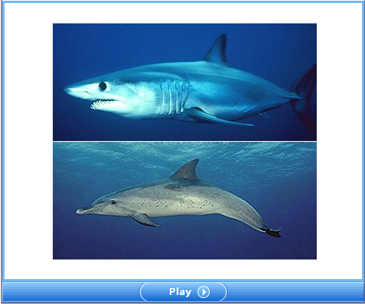
Why do species that are not closely related share some similar traits?
Convergent evolution occurs when similar traits develop in unrelated species because it helps them both survive in their common environment
  These traits that are similar in function but are dissimilar in evolutionary origin are know as analogous structures

Slide 13
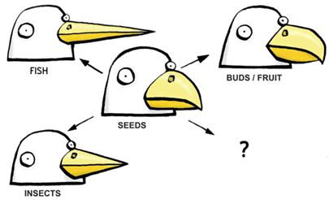
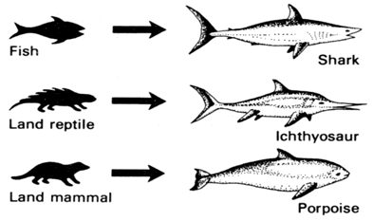
Convergence vs. Divergence
Identify the example: Convergent or Divergent?
  Take a moment to answer this question on your notesheet

Slide 14
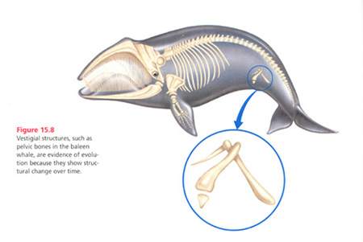
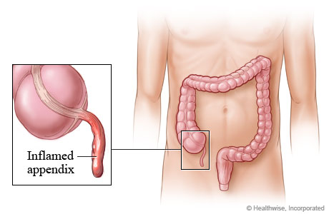
What happens when a trait becomes useless?
Vestigial structures are structures that do not serve a purpose but did in the species’ past.
  A species with a vestigial structure probably shares ancestry with a species that has a functional form of the structure.

Slide 15
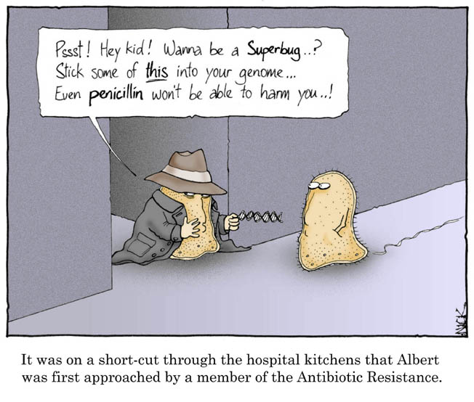
Can the evolution of one species affect another unrelated species?
The increasing occurrence of antibiotic resistance among bacteria is an example of coevolution in progress.

Slide 16
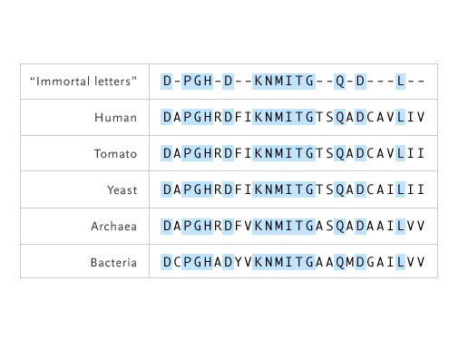
Are some traits are inherent in all living organisms?
Immortal genes are found in all organisms because they code for traits that are vital in the fundamental processes of life.

Slide 17
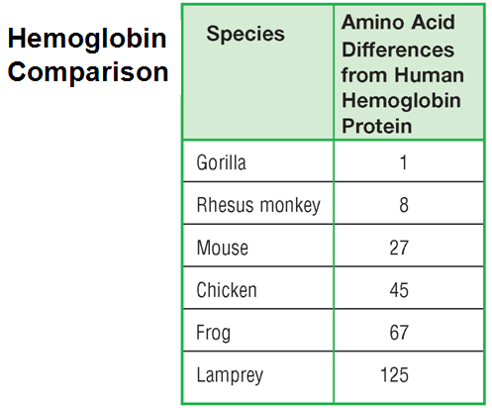
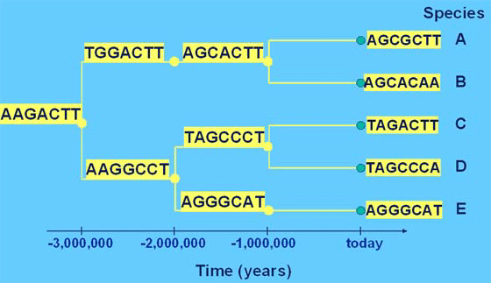
How does DNA provide evidence for evolution?
Biological molecules such as RNA, DNA, and proteins are used by all living organisms, indicating a common evolutionary history
  The more common the sequence,
  the more closely related

